Slide 1
Computer Networks
Gu Qing, Xia Nai
Nanjing University
2011年9月13日

Slide 2
Chapter 8. Internet Applications
Internet Applications Overview
Data Presentation and Formatting
Domain Name Service (DNS)
WWW and HTTP
Electronic Mail
File Transfer Protocol (FTP)
Simple Network Management Protocol (SNMP)
Content Distribution Networks (CDNs)

Slide 3
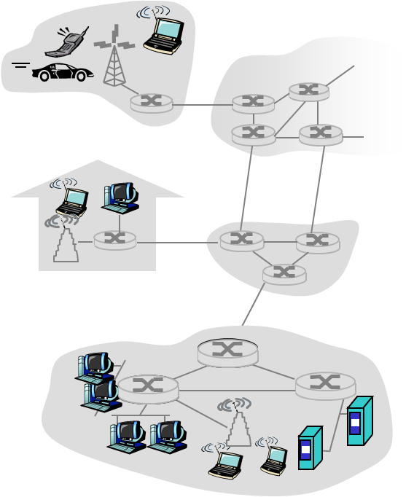
Internet Applications Overview
Application: communicating, distributed processes
e.g., Email, Web, P2P file sharing, instant messaging
Running in end systems (hosts)
Exchange messages to implement application
Application-layer protocols
One “piece” (agent) of an app
Define messages exchanged by apps and actions taken
Use communication services provided by lower layer protocols (TCP, UDP, RTP)
application
transport
network
data link
physical
application
transport
network
data link
physical
application
transport
network
data link
physical

Slide 4
Typical Internet Applications
Application | App-Layer Protocol | Underlying Transport Protocol
Email | SMTP [RFC 2821] | TCP
Remote terminal access | Telnet [RFC 854] | TCP
Web | HTTP [RFC 2616] | TCP
File transfer | FTP [RFC 959] | TCP
Streaming multimedia | Proprietary e.g. RealNetworks | RTP, RTSP TCP or UDP
Internet telephony | Proprietary e.g. Dialpad | SIP on UDP

Slide 5
Jargons of Internet Applications
Process: program running within a host
Within same host, 2 processes communicate using inter-process communication (defined by OS)
Processes running in different hosts communicate with an app-layer protocol
User agent: interfaces with app “above” and network “below”
Implements user interface & app-layer protocol, e.g.
Web: browser, web server
Email: mail reader, mail server
Streaming audio/video: media player, media server

Slide 6
App-Layer Protocols
Types of messages exchanged
e.g. request & response messages
Syntax of message types
What fields in messages & how fields are delineated
Semantics of the fields
Meaning of information in fields
Rules for when and how processes send & respond to messages

Slide 7
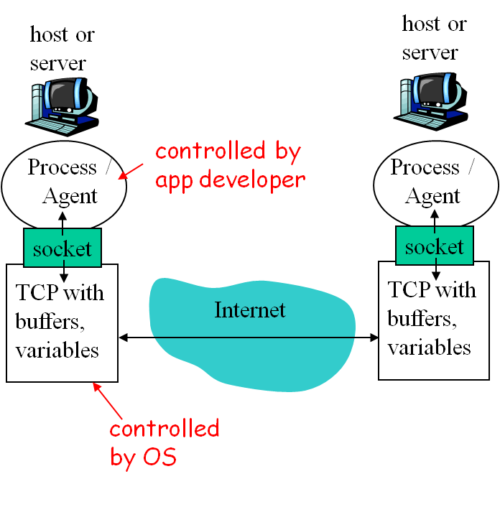
Sockets
Process sends/receives app messages to/from its socket
Each socket is mapped by the OS to a communicating app process
Different types of sockets
Stream sockets: by TCP
Datagram sockets: by UDP
Raw sockets: by-pass the transport layer
Notes:
Or UDP

Slide 8
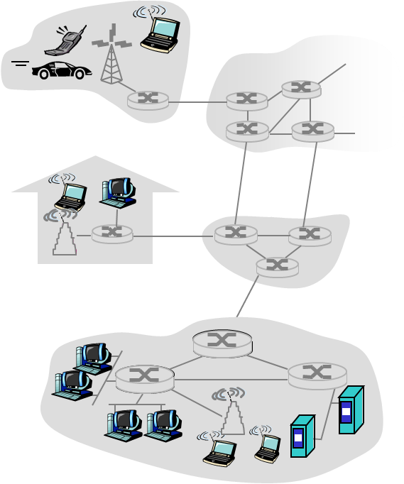
Client-Server Paradigm
Client:
Start as required
Initiates contact with server, “speaks first”
Host may have dynamic IP addresses
e.g. Web: client implemented in browser; Email: in mail reader
Server:
Run as daemon (always-on)
Provides requested service to Client
Host has permanent IP address
e.g. Web server sends requested Web page, mail server delivers Email
request
reply

Slide 9

Peer-2-Peer Paradigm
No always-on server
Arbitrary end systems directly communicate
Peers are intermittently connected and change IP addresses
Highly scalable but difficult to manage
Examples: Gnutella, BitTorrent, Skype
peer-peer

Slide 10
Client-Server and P2P
Skype
Voice-over-IP P2P application
Centralized server: finding address of remote party
Direct client-client connection
Instant messaging
Chatting between two users is P2P
Centralized service: user presence detection/location
User registers its IP address with central server when it comes online
User contacts central server to find IP addresses of parties

Slide 11
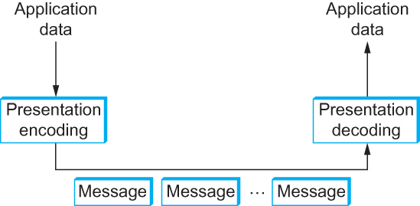
Data Presentation and Formatting
Format and delivery of application data
Key function is serialization of complex data structures into flat byte-strings
App-layer protocols typically accept only ASCII characters, transformation needed to support other form of data
Notes:
Sender: data encoding / marshalling
Receiver: decoding / unmarshalling

Slide 12

Presentation Formatting
Data Types
Basic types: integers, floats, characters
Complex types: arrays, structures, objects
e.g. ASN.1, Html/XML
Conversion
Translate from internal expression to external (transmission) expression
e.g. base 64
Tags
Additional info that helps receiver decode the msg

Slide 13
ASN.1
Abstract Syntax Notation One
ISO/ITU-T Standards: ISO 8824/ITU-T X.208
Abstract Syntax
Define data/data structure independent of machine-oriented structures and restrictions
Use in Internet Apps
Support the C type system
LDAP directory services, VoIP, SNMP
Notes:
ITU: International Telecommunications Union
Lightweight Directory Access Protocol
Simple Network Management Protocol

Slide 14
ASN.1 Definitions
Pre-defined basic types
e.g. INTEGER, BOOLEAN, OCTET STRING, BIT STRING
Constructor to build structured types
e.g. SEQUENCE, SEQUENCE OF, CHOICE, SET
Modules
A collection of ASN.1 descriptions
Basic Encoding Rules (BER)
Specify how ASN.1 defined data objects are transmitted
Each transmitted object as <Type, Length, Value> (TLV)
Notes:
SEQUENCE OF: Arrays
SEQUENCE: struct
CHOICE: union

Slide 15
Module Definition
EXPORTS
Definitions which may be imported by other modules
IMPORTS
Definitions to be imported from other modules
<module name> DEFINITIONS ::=
BEGIN
EXPORTS
IMPORTS
<Assignments List>
END
AssignmentList
Type assignments
Color ::= ENUMERATED{red (0), blue (1), yellow (2)}
Value (instance) assignments
Color defaultColor ::= blue
Macro definitions: define specific types and values
Notes:
Example of macro …**

Slide 16
Tags and Types
Every type defined with ASN.1 is assigned a tag
Tag = Class + Type Number
Class
Universal 0 0 (Bit 8,7 in BER)
Application 0 1
Context-specific 1 0
Private 1 1
Type Number
Non-negative Integer identifying specific type
e.g. 2 for integer, 3 for bit string, 28 for char string

Slide 17

ASN.1 Representation Example
A basic type
A complex type

Slide 18
An Example
Attendee ::= SEQUENCE {
LastName OCTET STRING,
Weight INTEGER
}
WangWu Attendee ::= {
LastName “Wang”,
Weight 258
}
Sequence
Length = 10
Integer
Length = 2
Value = 256+2
16
10
4
4
W
a
n
g
2
2
1
2
Value = “Wang”
Length = 4
Octet String

Slide 19
XML
Extensible Markup Language
Produced by World Wide Web Consortium (W3C)
A textual data format for representation of arbitrary data structures
Markups (tags) are mixed with data text to express information about the data
In case of HTML, markup merely indicates how the text should be displayed
XML can also express the type and structure of the data

Slide 20
XML Syntax
Provide for a nested structure (i.e. tree) of tag/value pairs
Tags are not pre-defined like in HTML
Instead, they can be defined in a Document Type Definition (DTD) or an XML Schema
Stored in a XML Schema Document (XSD)
A distinct schema can define a specific language based on XML
e.g. BPEL, WML, and many others
Notes:
Business Process Execution Language
Wireless markup language

Slide 21
An XML Example
<?xml version=“1.0” encoding=“ISO-8859-1”?>
<employee>
<name>John Doe</name>
<title>Head Bottle Washer</title>
<id>123456789</id>
<hiredate>
<day>5</day>
<month>June</month>
<year>1986</year>
</hiredate>
</employee>
XML declaration line, defines version and the character type
Root element
Tags appear in pairs
Nested definition

Slide 22
Corresponding XSD
<?xml version=“1.0”? encoding=“ISO-8859-1”>
<schema xmlns="http://www.w3.org/2001/XMLSchema">
<element name="employee">
<complexType>
<sequence>
<element name="name" type="string"/>
<element name="title" type="string"/>
<element name="id" type="string"/>
<element name="hiredate">
<complexType>
<sequence>
<element name="day" type="integer"/>
<element name="month" type="string"/>
<element name="year" type="integer"/>
</sequence>
</complexType>
</element>
</sequence>
</complexType>
</element>
</schema>

Slide 23
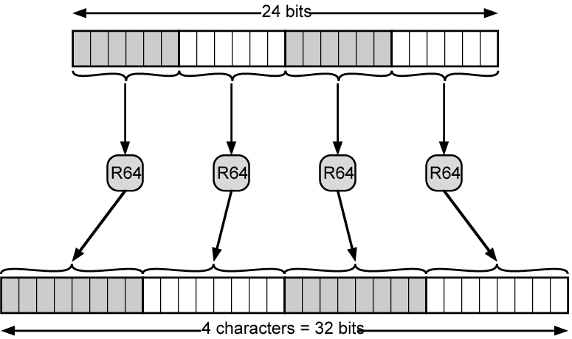
Base 64
Also called Radix-64 encoding, assume arbitrary binary data as input, output 7-bit ASCII chars
Each 3 octets of data mapped to 4 ASCII Chars
Only 65 chars used: A~Z, a~z, 0~9, +, /, =
‘newline’ is inserted to keep output line lengths below 76 chars

Slide 24
Radix-64 Code Table
0 A
1 B
2 C
3 D
4 E
5 F
6 G
7 H
8 I
9 J
10 K
11 L
12 M
13 N
14 O
15 P
16 Q
17 R
18 S
19 T
20 U
21 V
22 W
23 X
24 Y
25 Z
26 a
27 b
28 c
29 d
30 e
31 f
32 g
33 h
34 i
35 j
36 k
37 l
38 m
39 n
40 o
41 p
42 q
43 r
44 s
45 t
46 u
47 v
48 w
49 x
50 y
51 z
52 0
53 1
54 2
55 3
56 4
57 5
58 6
59 7
60 8
61 9
62 +
63 /
pad =

Slide 25
Base 64 Coding Example
201
102
93
1
1
0
0
1
0
0
1
1
1
0
0
0
1
1
0
0
1
0
1
1
1
0
1
50
28
25
29
y
c
Z
d
If input is not multiples of 3 octets
Add 4 / 2 bit 0, then pad with ‘=’
201
1
1
0
0
1
0
0
1
0
0
0
0
50
16
0
0
y
Q
=
=

Slide 26
Domain Name Service (DNS)
Function
Map “domain names” into IP addresses
e.g. www.baidu.com → 119.75.217.109
Domain Name System
Distributed database implemented in hierarchy of many name servers
App-layer protocol host and name servers to communicate to resolve “domain names”
Load balancing: set of IP addresses for one server name

Slide 27
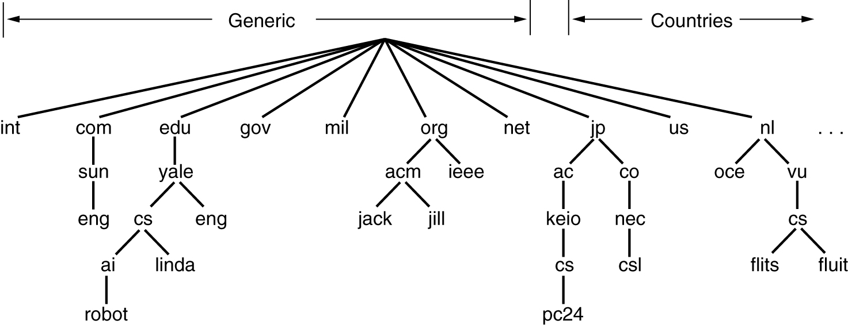
Domain Name Space
Consist of a tree (hierarchy) of domain nodes
A canonical name starts from a leaf node, and ends with a root node
e.g. robot.ai.ca.yale.edu

Slide 28
Distributed, Hierarchical Database
A domain zone is a subtree of the domain nodes
One domain server maintains a domain zone
Root DNS Servers
com DNS servers
org DNS servers
edu DNS servers
yahoo.com
DNS servers
pbs.org
DNS servers
poly.edu
DNS servers
umass.edu
DNS servers
amazon.com
DNS servers
Client Bob wants IP for www.amazon.com
Bob queries a root server to find com DNS server
Bob queries com DNS server to get amazon.com DNS server
Bob queries amazon.com DNS server to get IP address for www.amazon.com
Notes:
Bob’s agent

Slide 29
Hierarchy of DNS Servers
Top-level domain servers
Responsible for com, org, net, edu, etc, and all top-level country domains, e.g. cn, uk, fr
Authoritative DNS servers
Organization’s DNS servers, providing authoritative hostname to IP mappings
Local Name Servers
Maintained by each residential ISP, company, university
When host makes DNS query, query is sent to its local DNS server
Notes:
Authoritative指管理者
Local指查询者

Slide 30
DNS Name Resolution Example
Bob at cis.poly.edu wants IP address for Alice at gaia.cs.umass.edu
root DNS server
2
3
TLD DNS server
Iterated query:
Contacted server replies with name of next server to contact
Host-Server: iterative query
Server-Server: one-step query
4
5
local DNS server
dns.poly.edu
7
6
1
8
authoritative DNS server
dns.cs.umass.edu
requesting host
cis.poly.edu
gaia.cs.umass.edu
Notes:
Top-level domain

Slide 31
DNS Records
Once a name server learns mapping, it caches the mapping
Cache entries timeout (disappear) after some time, re-consult needed
TLD servers typically cached in local name servers
A DNS resource record (RR)
RR format: (name, value, type, ttl)
“Name” is the domain name, “type” denotes how “value” is explained
e.g. Name Server records (NS), Mail Exchangers (MX), Host IP Address (A), Canonical name (CNAME)
Examples
(networkutopia.com, dns1.networkutopia.com, NS, 32768)
(dns1.networkutopia.com, 212.212.212.1, A, 5600)
Notes:
NS: Authoritative DNS server

Slide 32
Web and HTTP
Web jargons
A Web page consists of objects
An Object can be HTML file, JPEG image, Java applet, audio file, …
Web page is composed of base HTML-file which includes several referenced objects
Each object is addressable by a URL
HTTP (Hypertext Transfer Protocol)
Underlying protocol of the WWW (World Wide Web)
Transfer objects (plain text, hypertext, audio, images, and other accessible info) over Internet

Slide 33
URL – Uniform Resource Locator
A unique identifier for an object on WWW
URL format
<protocol>://<host>:<port>/<path>?query_string
Protocol: method for transmission or interpretation of the object, e.g. http, ftp, Gopher
Host: DNS name or IP address of the host where object resides
Path: pathname of the file that contains the object
Query_string: name/value pairs sent to app on the server
An example
http://www.nju.edu.cn:8080/somedir/page.htm
Notes:
URI: Uniform Resource Identifier

Slide 34
HTTP Overview
Web's application layer protocol
Uses TCP connections
Client/Server model
Client: browser that requests, receives, “displays” Web objects
Server: Web server sends objects in response to requests
HTTP versions
HTTP 1.0: RFC 1945
HTTP 1.1: RFC 2068
HTTP request
PC running
Explorer
HTTP response
HTTP request
Server
running
Apache Web
server
HTTP response
Mac running
Navigator

Slide 35
HTTP Procedure
Based on TCP connection
Client initiates TCP connection (creates socket) to server, use port 80
Server accepts TCP connection from client
HTTP msgs exchanged between browser (HTTP client) and Web server (HTTP server)
TCP connection closed by server after that
HTTP is stateless
Each transaction (connection) treated independently
Server maintains no information about past client requests

Slide 36
HTTP Connections
Nonpersistent HTTP
At most one object is sent over a TCP connection
By Http 1.0
Persistent HTTP
Multiple objects can be sent over single TCP connection between client and server
HTTP 1.1 uses persistent connections in default mode

Slide 37
Nonpersistent HTTP
When user enters URL
http://www.someSchool.edu/someDepartment/home.index
Http Client (Browser)
Http Server
1a. C initiates TCP connection to S at www.someSchool.edu on port 80
1b. S at www.someSchool.edu listening at port 80, accepts connection, notifying C
2. C sends HTTP request msg indicating that C wants object someDepartment/home.index
time
3. S receives request msg, forms response msg containing requested object, and sends back
5. C receives response msg, parses and displays html file, finds 10 referenced jpeg objects
4. S closes TCP connection
6. Steps 1~5 repeated for each of 10 jpeg objects

Slide 38
Persistent HTTP (1)
Nonpersistent HTTP
Requires one transaction per object
Browsers often open parallel TCP connections to fetch referenced objects
OS must work and allocate host resources for each TCP connection
Persistent HTTP
Server leaves connection open after sending response
Subsequent HTTP messages between same client / server are sent over connection

Slide 39
Persistent HTTP (2)
Persistent without pipelining
Client issues new request only when previous response has been received
One RTT for each referenced object
Persistent with pipelining
Client sends requests as soon as it encounters a referenced object
As little as one RTT for all the referenced objects
Default in HTTP 1.1

Slide 40
HTTP Request Message
2 types of HTTP messages: Request, Response
Message in 7-bit ASCII (human-readable format)
request line (GET, POST, HEAD commands)
GET /somedir/page.html HTTP/1.1
Host: www.someschool.edu
User-agent: Mozilla/4.0
Connection: close
Accept-language:fr
(extra CR or LF)
header
lines
CR, LF indicates end of message

Slide 41
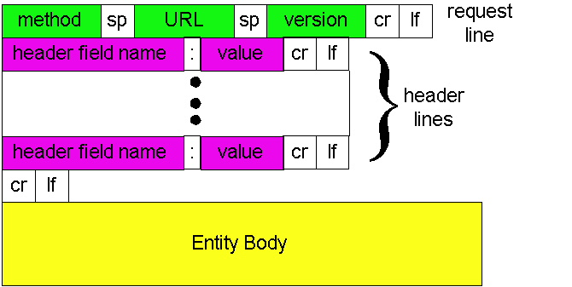
Request Message in Detail

Slide 42
2 Common Request Methods
Post method
Web page often includes form input
Input is uploaded to server in entity body using post
Get method
Retrieve information on Server by URL, and display
Other common methods
Head (retrieve only headers)
By HTTP 1.1: Put, Delete
Notes:
i.e. titles

Slide 43
HTTP Response Message
Message also in 7-bit ASCII (human-readable format)
status line
(code + phase)
HTTP/1.1 200 OK
Connection close
Date: Thu, 06 Aug 2003 12:00:15 GMT
Server: Apache/1.3.0 (Unix)
Last-Modified: Mon, 22 Jun 1998 …
Content-Length: 6821
Content-Type: text/html
data data data data data … …
header
lines
data, e.g. requested HTML file

Slide 44
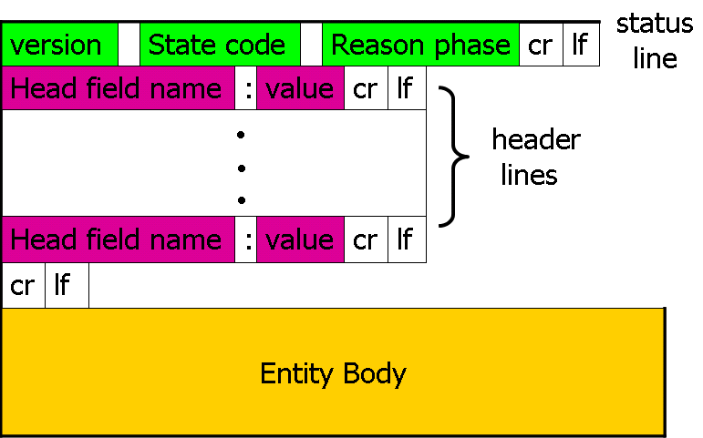
Response Message in Detail
Status-Line
HTTP-Version <SP> Status-Code <SP> Reason-Phrase <CRLF>

Slide 45
Typical HTTP Status Codes
200 OK
Request succeeded, requested object later in this message
301 Moved Permanently
Requested object moved, new location specified later in this message (Location:)
400 Bad Request
Request message not understood by server
404 Not Found
Requested document not found on this server
505 HTTP Version Not Supported

Slide 46
Entity Body
Arbitrary sequence of octets specifying the resource
HTTP transfers any type of data
Text, Binary data
Audio, Images, Video
Interpretation of data determined by header fields
Content-Type: text/html; charset = ISO-8859-4
Content-Encoding: gzip
Transfer-Encoding: chunked

Slide 47
User-Server Interaction: Authorization
Authorization: control access to server content
Authorization header line in each request
Authorization credentials: typically name, password
Stateless: client must present authorization in each request
client
server
usual http request msg
401: authorization req.
WWW authenticate
usual http request msg
Authorization: <cred>
usual http response msg
usual http request msg
Authorization: <cred>
usual http response msg
time

Slide 48
Cookies: Keeping State
Many major Web sites use cookies
Keep track of client’s status on server
Major components
Cookie header line in the HTTP request / response message
Cookie file kept on client’s host and managed by client’s browser
Back-end database at Web server site

Slide 49
A Cookies Example
Client
Server
ebay 8734
usual http request msg
Amazon server
creates ID
1678 for user
cookie file
usual http response
Set-cookie: 1678
create
entry
ebay 8734
amazon 1678
usual http request msg
cookie: 1678
cookie-
specific
action
access
one week later:
usual http response msg
backend
database
access
ebay 8734
amazon 1678
usual http request msg
cookie: 1678
cookie-
spectific
action
usual http response msg

Slide 50
Application of Cookies
aside
What cookies can bring
Authorization
Shopping carts
Recommendations
User session state (Web Email)
Cookies and privacy
Cookies permit servers to learn a lot about user
User may supply name and Email to servers
Search engines may use cookies to obtain info across sites
Hacked browser may do bad things with cookies

Slide 51
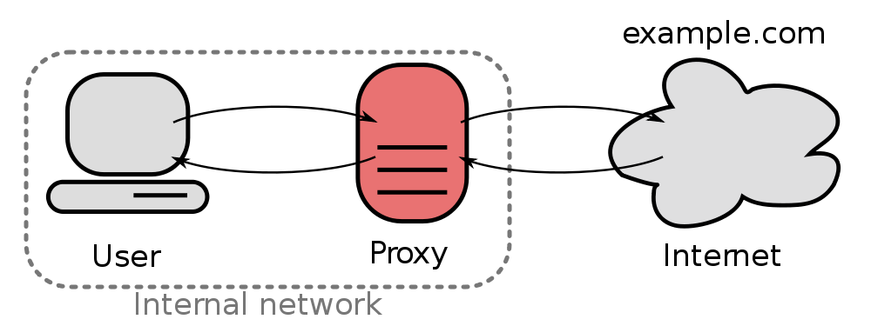
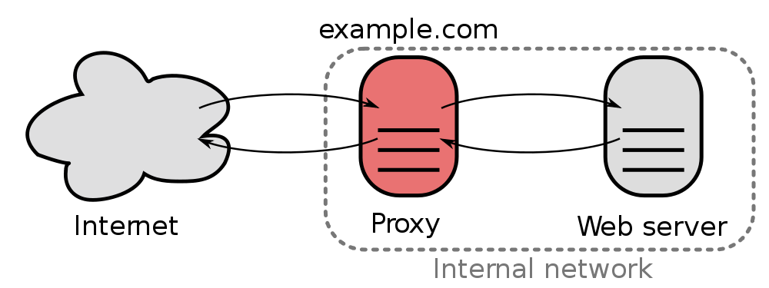
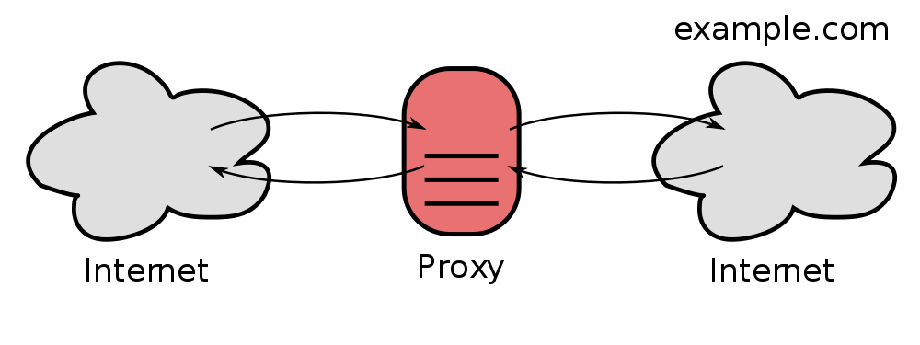
Proxy Server
An intermediary app that
Represents the client to issue request, and
Represents the server to give response
Different types

Slide 52


Web Caches
User sets browser: Web accesses via cache
Browser sends all HTTP requests to cache on proxy server
Object in cache: cache returns object
Or cache requests object from origin server, then returns object to client
Proxy
server
HTTP request
HTTP request
client
HTTP response
HTTP response
origin
server
HTTP request
HTTP response
client

Slide 53
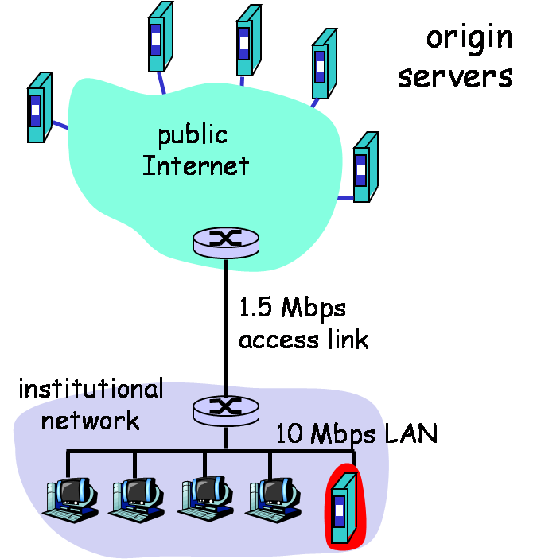
Caching Example
Institutional cache
Satisfy internal client request without involving origin server
Considerations
Smaller response time
Decrease traffic to distant servers
Load balancing
Notes:
Proxy in this figure
Client request, response if resource in cache, else get and buffer resource from server

Slide 54
Caching Example
One trip delay = Internet delay + access delay + LAN delay
Suppose
Internet delay = 2 sec
LAN delay = 2 msec
Access delay = 10 msec
Suppose hit rate is 0.4 (40%)
Access without cache:
(2000+2+10)×2 = 4024 msec = 4.02 sec
Access with cache:
(2+10 + 0.6×2000)×2 = 2424 msec = 2.4 sec

Slide 55
Conditional GET
Goal
Don’t send object if proxy has up-to-date cached version
Client (Proxy)
Specify date of cached copy in HTTP request
Server
Response contains no object if cached copy is up-to-date
server
proxy
HTTP request msg
If-modified-since: <date>
object
not
modified
HTTP response
HTTP/1.0
304 Not Modified
HTTP request msg
If-modified-since: <date>
object
modified
HTTP response
HTTP/1.0 200 OK
<data>

Slide 56
Electronic Mail
One of most heavily used apps on Internet
SMTP: Simple Mail Transfer Protocol
Delivery of simple text messages
MIME: Multi-purpose Internet Mail Extension
Delivery of other types of data, e.g. voice, images, video clips
POP: Post Office Protocol
Msg retrieval from server, including authorization and download
IMAP: Internet Mail Access Protocol
Manipulation of stored msgs on server

Slide 57
Components of Email System
User Agent
Composing, editing, reading mail messages
e.g. Eudora, Outlook, Foxmail, Netscape Messenger
Outgoing, incoming mail messages stored on server
Mail Servers (Host)
Mailbox contains incoming mail messages for user
Message queue of outgoing mail messages
SMTP protocol between mail servers to send mail messages
outgoing
message queue
user
agent
user mailbox
mail
server
user
agent
SMTP
mail
server
user
agent
SMTP
SMTP
mail
server
user
agent
user
agent
user
agent

Slide 58
3 Stages of Mail Delivery
1st Stage
Email goes from local user agent to the local SMTP server
User agent acts as SMTP client
Local server acts as SMTP server
2nd Stage
Email is relayed by the local server to the remote SMTP server
Local server acts as SMTP client now
3rd Stage
The remote user agent uses a mail access protocol to access the mailbox on remote server
POP3 or IMAP4

Slide 59
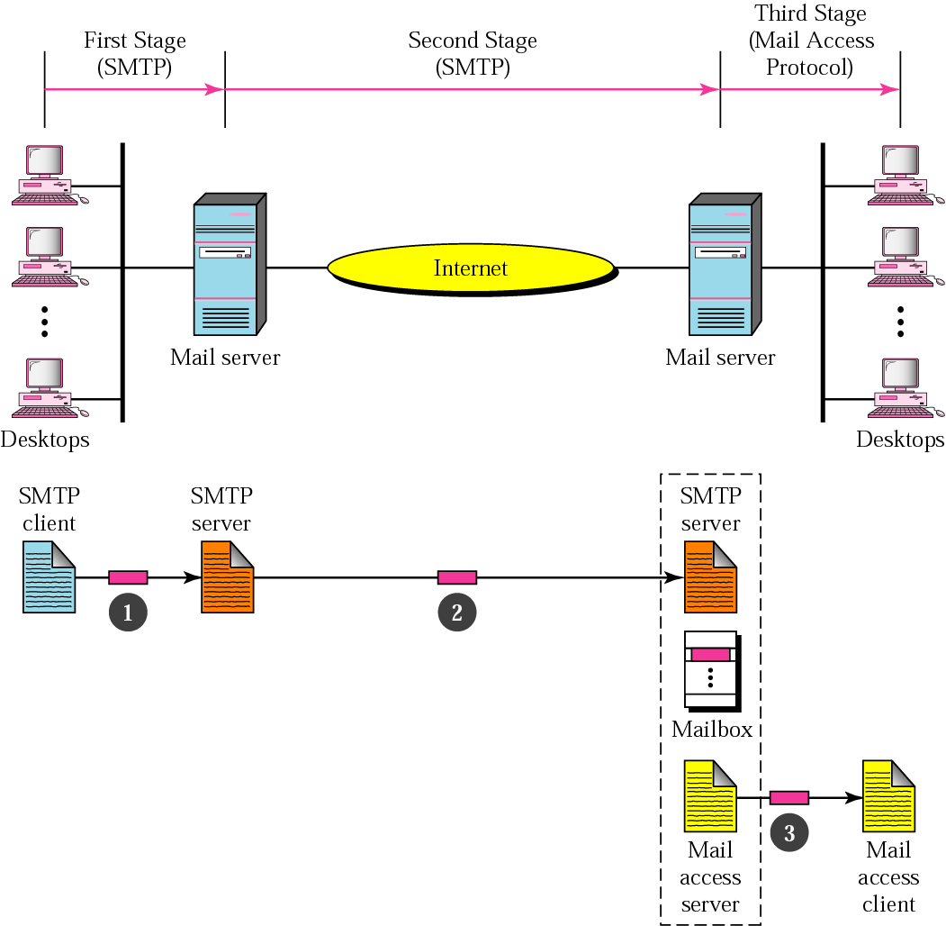
Illustration of Mail Delivery
Pop3, IMAP4, or HTTP
RFC 822, MIME

Slide 60


A Mail Delivery Scenario
Alice uses UA to compose a mail message and to bob@someschool.edu
Alice’s UA sends mail to her mail server using SMTP, mail placed in message queue
Client side of SMTP opens TCP connection with Bob’s mail server
SMTP client sends Alice’s mail over the TCP connection
Bob’s mail server places the mail in Bob’s mailbox
Bob invokes his UA to read the mail, e.g. by Pop3
1
mail
server
mail
server
user
agent
user
agent
2
3
6
4
5
Notes:
User Agent

Slide 61
SMTP
RFC 821:
Uses TCP, port 25
Direct transfer: transfer Email message from client to server
Needs info written on envelope of a mail (i.e. message header)
May add log info to message header to show the path taken
Does not cover format of mail messages or data
Defined in RFC 822 or MIME
Messages must be in 7-bit ASCII
Notes:
奇偶校验占1位

Slide 62
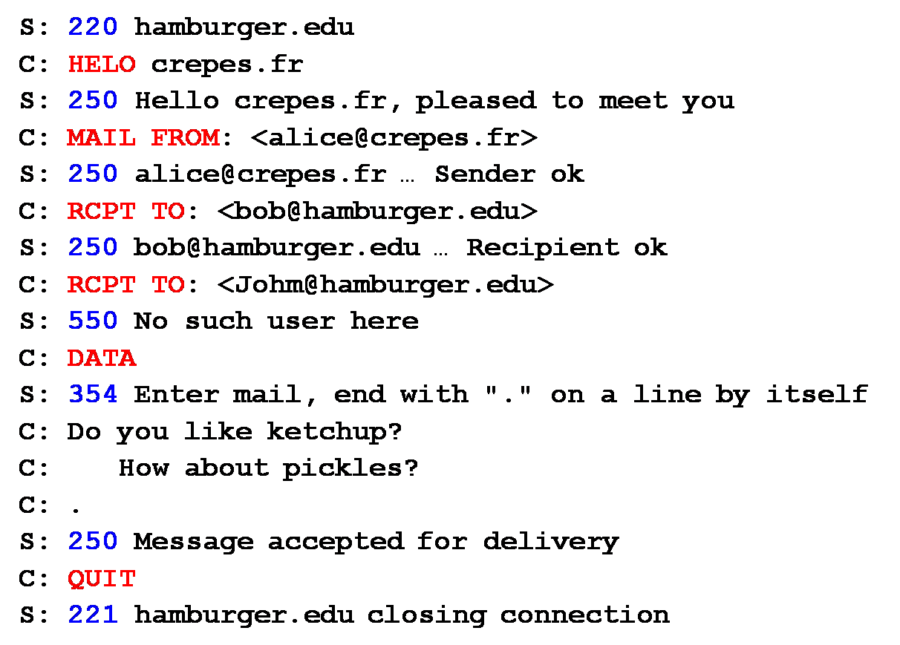
SMTP Transaction
3 phases of transfer
Handshaking (greeting)
Transfer of one or more mails data
Close connection
Command/response interaction
Commands: ASCII text
Response: status code and phrase
Notes:
Sender first opens TCP connection with receiver, port 25

Slide 63
Reliability of SMTP
Transfer mails from sender to receiver over TCP connection
Rely on TCP to provide reliable service
No guarantee to recover lost mails
No end to end acknowledgement to originator (user)
Error indication delivery not guaranteed
Indicates mail has arrived at host, but not user
Generally considered reliable
Notes:
Only host level ACKs

Slide 64
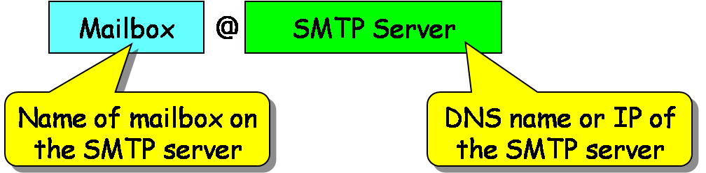
An Email Message
Header lines, e.g.
To: Alice@sina.com
From: Bob@gmail.com
Subject: Dinner tonight
Body
Mail contents, ASCII characters only
header
blank
line
body
Mail destinations

Slide 65
Mail Gateway
Provide single mail destination point for all incoming mail
Arrange to have mail forwarded to specific destination address
Forwarded mail can use proprietary (non-SMTP) mail system
Zhang_xi | zxi@cs.nju.edu.cn
Wang_wu | wwu@phy.nju.edu.cn
Li_Hui | lh@dislab.nju.edu.cn

Slide 66
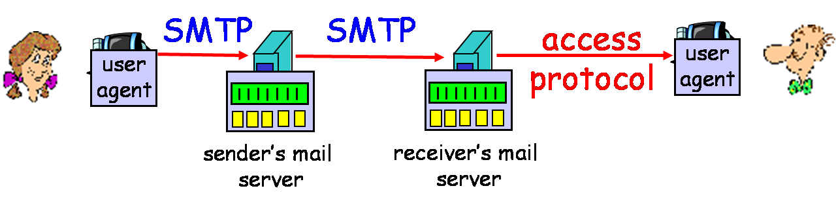
Mail Access Protocols
SMTP: delivery/storage to receiver’s server
Mail access protocol: mail retrieval from server
POP: Post Office Protocol [RFC 1939]
Authorization (agent <-->server) and download
IMAP: Internet Mail Access Protocol [RFC 1730]
Manipulation of stored mails on server
HTTP: gmail, Hotmail, Yahoo!, etc.

Slide 67
POP3 Protocol
S: +OK POP3 server ready
C: user bob
S: +OK
C: pass hungry
S: +OK user successfully logged on
Authorization phase
Client commands
user: declare username
pass: password
Server responses
+OK
-ERR
Transaction phase, by client
list: list mail numbers
retr: retrieve mail by number
dele: delete
quit
C: list
S: 1 498
S: 2 912
S: .
C: retr 1
S: <message 1 contents>
S: .
C: dele 1
C: retr 2
S: <message 1 contents>
S: .
C: dele 2
C: quit
S: +OK POP3 server signing off

Slide 68
IMAP
Internet Mail Access Protocol, RFC 1730
A complicated use case
Bob reads emails at his office while his wife is simultaneously reading from same mailbox at home
IMAP features
Keeps all mails in a central mail pool on server
Allows user to organize mails in folders
Keeps user state across sessions, e.g.
Mappings between mail IDs and folder name
Keeps track of mail states (read, replied, deleted)

Slide 69
RFC 822 – Format for Text Mails
Simple 2-part format
Header (envelope) includes transmit and delivery info
Lines of text in format keyword: information value
Body (contents) carries text of message
Header and body separated by a blank line
Mail is a sequence of lines of text
Ends with two <CRLF>
From: John@hamburger.edu
To: Alice@crepes.fr
Cc: bob@hamburger.edu
Date: Wed, 4 Sep 2003 10:21:22 EST
Subject: Lunch with me
Alice,
Can we get together for lunch when you visit next week? I'm free on Tuesday or Wednesday. Let me know which day you would prefer.
John

Slide 70
MIME
Multipurpose Internet Mail Extension
Extends and automates encoding mechanisms
Allows inclusion of separate components in a single mail
e.g. programs, pictures, audio clips, videos
Features
Compatible with existing mail systems
Everything encoded as 7-bit ASCII
Headers and separators ignored by non-MIME mail systems
MIME is extensible
As long as sender and receiver agree on encoding scheme

Slide 71
Overview of MIME
5 new mail header fields
MIME version
Content type
Content transfer encoding
Content Id
Content Description
Number of content formats defined
Transfer encoding defined

Slide 72
A MIME Mail Example
From: alice@crepes.fr
To: bob@hamburger.edu
Subject: Picture of yummy crepe.
MIME-Version: 1.0
Content-Transfer-Encoding: base64
Content-Type: image/jpeg
base64 encoded data .....
.........................
......base64 encoded data
MIME version
Method used
to encode data
Type of data
encoded data

Slide 73
A Multi-Part Example
From: alice@crepes.fr
To: bob@hamburger.edu
Subject: Picture of yummy crepe.
MIME-Version: 1.0
Content-Type: multipart/mixed; boundary="StartOfNextPart"
--StartOfNextPart
Dear Bob, Please find a picture of a crepe.
--StartOfNextPart
Content-Transfer-Encoding: base64
Content-Type: image/jpeg
base64 encoded data .....
.........................
......base64 encoded data
--StartOfNextPart
Do you want the recipe?
--StartOfNextPart--

Slide 74
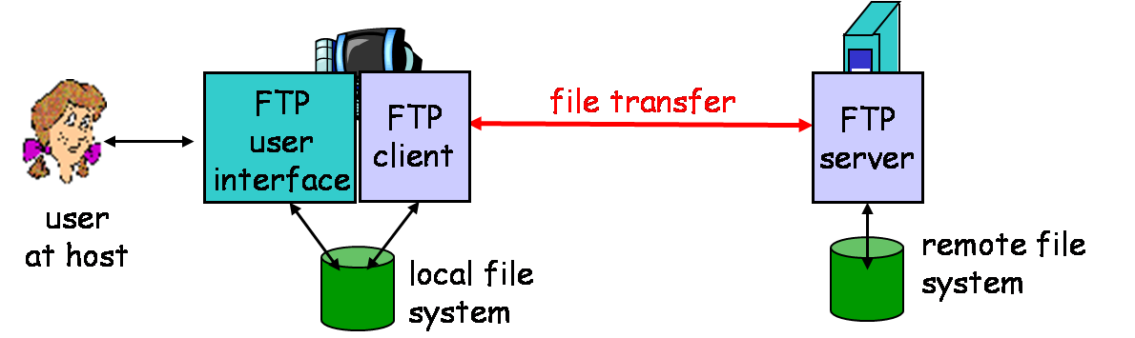
File Transfer Protocol (FTP)
RFC 959, use TCP, port 21/20
Transfer file to/from remote host
Client/Server model, client side initiates file transfer
Deals with heterogeneous OS and file systems
Needs access control on remote file system
Notes:
Binary mode and Text mode
CR (Carriage return) + LF (Line Feed)

Slide 75
Control and Data Connections
FTP client contacts FTP server at port 21, opens a control connection
Client authorized over control connection
Client browses remote directory by sending commands over control connection
When server receives file transfer command, data connection is opened
Push mode, file owner start connection
One connection for each file transferred
Control connection stays “out of band”
FTP server maintains “user state”: current directory, earlier authentication

Slide 76
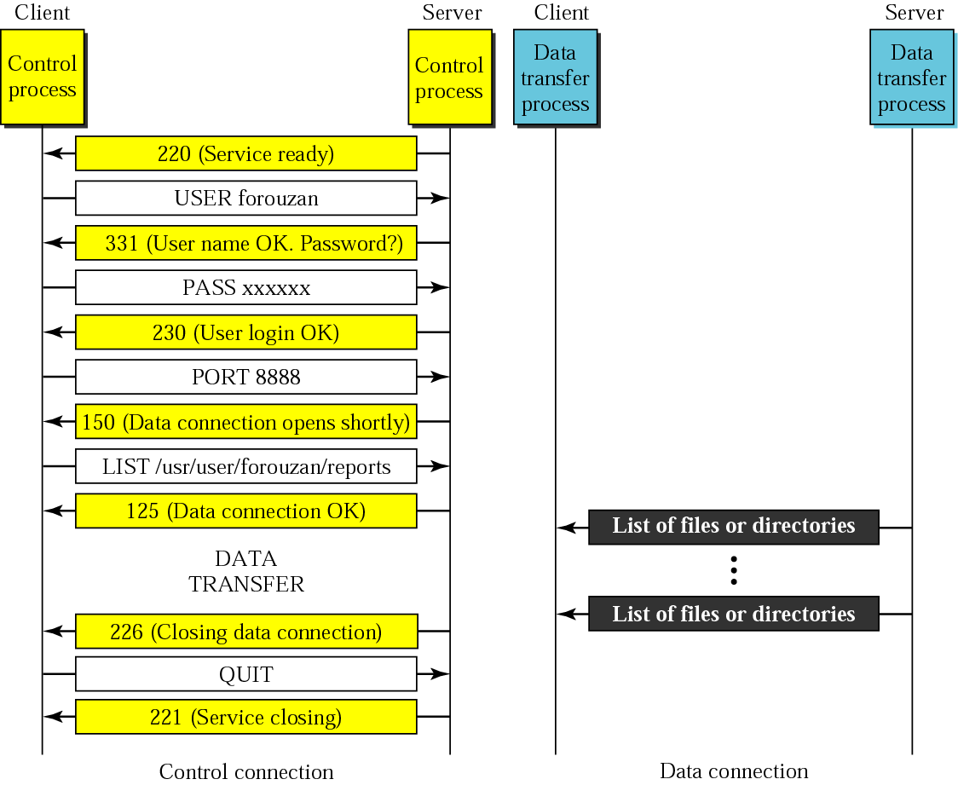
Illustration of FTP Session

Slide 77
FTP Commands and Responses
Sample commands:
Sent as ASCII text over control channel
USER username
PASS password
LIST return list of file in current directory
RETR filename retrieves (gets) file
STOR filename stores (puts) file onto remote server
Sample return codes:
Status code and phrase (as in HTTP)
331 Username OK, password required
125 data connection already open; transfer starting
425 Can’t open data connection
452 Error writing file

Slide 78
Simple Network Management Protocol (SNMP)
Simple Network Management Protocol
De facto standards of network management for TCP/IP networks (Internet)
Defines management information base (MIB)
One or more Management Stations
Perform management applications, give operator interface
Multiple Network Elements
Hosts, routers, gateways, …, each contains an Agent
Network Management Protocol
Exchange network management information

Slide 79
Key Components
Management Station
Management station (manager)
Agent
Network management protocol
Management information base
Printer MIB
Modem MIB
ISDN MIB
UPS MIB
Management Agents

Slide 80
Management Station
Server system with operator console
Set of management applications
Data analysis, Fault recovery
Interface for human network manager to monitor & control network
Translate manager’s requirements into monitoring and control of remote elements
Maintain Database of network management info extracted from managed elements

Slide 81
Management Agent
Hosts, bridges, hubs, routers equipped with agent software
Allow them to be managed from management station
Respond to manager’s requests for info
Respond to manager’s requests for action
Asynchronously supply manager with important but unsolicited info

Slide 82
Management Information Base
Each network element (NE) has multiple resources
Each resource managed comprises a set of managed objects (MOs)
Essentially, each MO is a data variable, e.g. buffer size
The MIB is a structured collection of MOs
Each agent in an NE maintains a MIB
Managed Resources
MIB
Agent
SNMP
UDP
IP
NI

Slide 83
Network Management Protocols
Communication protocol between management stations and agents
Provides a standard way to exchange management info
Internet: SNMP (v1~v3)
ISO/ITU-T X.700 Series: CMIP/S (Common Management Information Protocol / Service)
ITU-T M.3000 Series: TMN (Telecommunication Management Networks)
Notes:
ITU: International Telecommunications Union

Slide 84
SNMP Protocol Layer
Management
Station
Network Elements (NEs)
Host
Router
Manager
Agent
Agent
SNMP
SNMP
. . .
SNMP
162
Network
Management
Protocol
161
161
UDP
UDP
UDP
IP
IP
IP
NI
NI
NI
Internet
Notes:
NI: Network Interface

Slide 85
SNMP Protocol Capabilities
Get
Manager retrieves the values of objects in the MIB of an agent
Get-Next
Retrieve the values of the next objects in the MIB of an agent
Set
Manager updates the values of objects in the MIB of an agent
Trap (Notify)
Agent reports extraordinary events to the manager

Slide 86
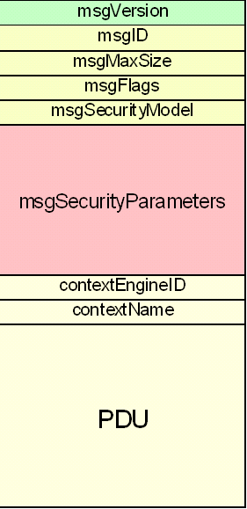
SNMP v3 Message
Differentiate message processing, v1, v2c, v3
SNMP processing
msgID matches response messages to request messages
Security support
Access control
Control fields + Variable bindings

Slide 87
SNMP Operation Example
Management
Station
PC
UNIX
MIB
...
FDDI
....
Get
RMON
Device
Trap
Firewall
/ Router
....
....
UNIX
...
PC
Internet
UNIX
PC
Notes:
Agent on router, host, bridge, server

Slide 88
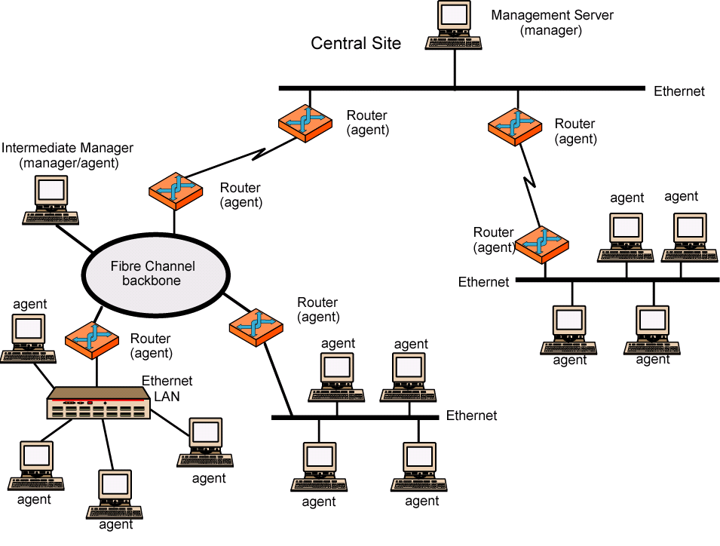
A Distributed Management Configuration

Slide 89
Structure of Management Information
SMI (RFC 1155)
Defines general framework within which MIB is defined and constructed
How resources are represented and named
Features
Defines managed object as an ASN.1 Module
Scalars and two dimensional arrays of scalars (tables) only for naming

Slide 90
SNMP Naming
Object Identifier (OID)
Global identifier for a particular object type
Organized in a standardized global object identifier tree
An OID consists of a sequence of integers, which specify the position of the object in the tree
1.3.6.1.2.1.7.1
ISO
ISO-ident. Org.
US DoD
Internet
UDPInDatagrams
UDP
MIB II
Management

Slide 91
Objects in a UDP Module
OID | Object Name | Object Type | Comments
1.3.6.1.2.1.7.1 | UDPInDatagrams | Counter32 | Total # datagrams delivered
1.3.6.1.2.1.7.2 | UDPNoPorts | Counter32 | # undeliverable datagrams due to no app at port
1.3.6.1.2.1.7.3 | UDPInErrors | Counter32 | # undeliverable datagrams due to other reasons
1.3.6.1.2.1.7.4 | UDPOutDatagrams | Counter32 | # datagrams sent
1.3.6.1.2.1.7.5 | UDPTable | Sequence | port # + IP address, one entry for each port in use by app

Slide 92
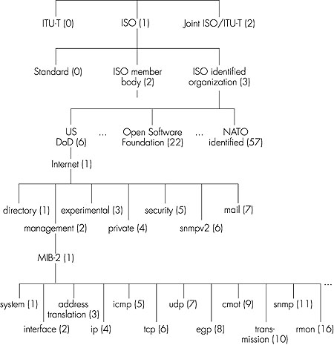
Object Identifier Tree
1.3.6.1.2.1
1.3.6.1.2.1.7

Slide 93
Content Distribution Networks (CDNs)
Challenge
Stream large files (e.g. video) from single origin server in real time
Protect origin server from DDOS attacks
Solution
Replicate content at hundreds of servers throughout Internet
CDN distribution node coordinate the content distribution
Placing content close to user
Origin server
in North America
CDN distribution node
CDN server
in S. America
CDN server
in Asia
CDN server
in Europe

Slide 94
Content Replication
Content provider (origin server) is CDN customer
CDN replicates customers’ content in CDN servers
When provider updates content, CDN updates its servers
Use authoritative DNS server to redirect requests

Slide 95
Supporting Techniques
DNS
One name maps onto many addresses
Routing
Content-based routing (to nearest CDN server)
URL Rewriting
Replaces “http://www.sina.com/sports/tennis.mov” with “http://www.cdn.com/www.sina.com/sports/tennis.mov”
Redirection strategy
Load balancing, network delay, cache/content locality

Slide 96

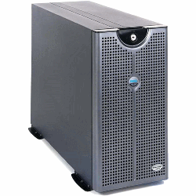

CDN Operation
1’ URL rewriting – get authoritative server
Get near CDN server IP address
Warm up CDN cache
Retrieve pages/media from CDN Server
CDN Server
CDN authoritative Server
3
2
1
1
Client
Origin Server

Slide 97
Redirection
CDN creates a “map”, indicating distances from leaf ISPs and CDN servers
When query arrives at authoritative DNS server
Server determines ISP from which query originates
Uses “map” to determine best CDN server
CDN servers create an application-layer overlay network

Slide 98
Chapter Goals
Conceptual, implementation aspects of network application protocols
Client-Server vs. Peer-to-Peer
Data presentation formatting
Examining popular application-level protocols
DNS, SNMP / MIB
HTTP, FTP, SMTP / POP3 / MIME
Content distribution networks (CDNs)

